Slide 1
Encoder-Decoder Architecture
CSE 427
Reference: Attention Is All You Need

Slide 2
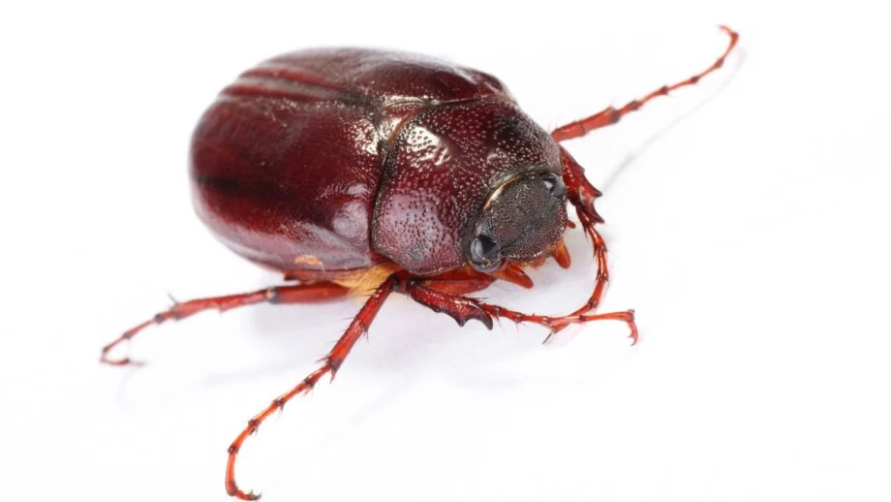

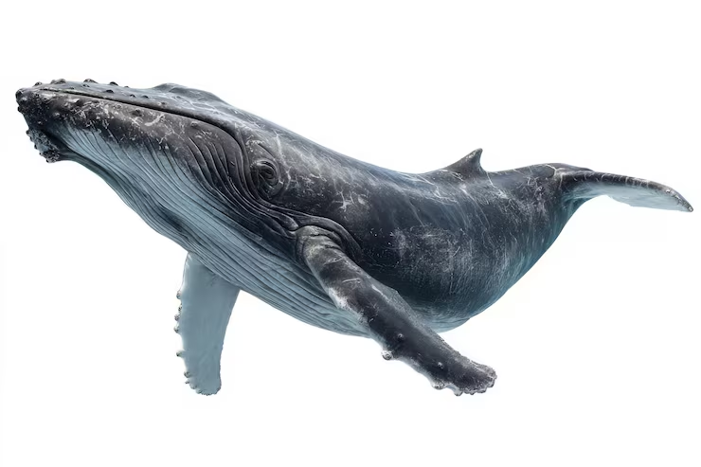

So far What we have
We have word embedding summed with positional encoding.
Still not enough!!
We still don't have contextual information
Like, look at the following sentence:
“A fluffy blue creature”
Focus on the word creature. After word embedding it still has a generic representation. When we incorporate the impact of fluffy and blue, maybe we get a representation of

Slide 3
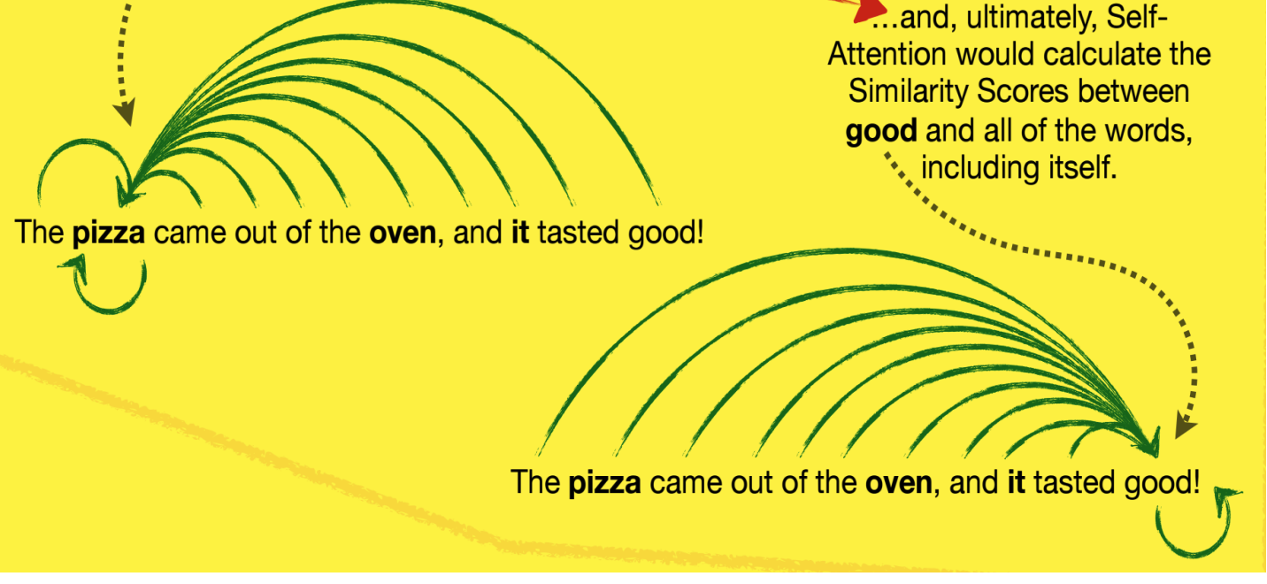
Self Attention
self-attention produces a new, context-aware embedding that is a blend of information from all other words (Including itself)

Slide 4
Query, Key and Value
This is the heart of self-attention. The paper introduces three vectors for each token: Query (Q), Key (K), and Value (V).
The Analogy: A Library Search System
 | Self-Attention Role | Library Analogy
Query | What the current word is "looking for." | Your search query: "I want a book about cats"
Key | A label that describes what information this word "offers." in terms to the question context | Each book's index card / catalog entry
Value | The actual information the word contains, which will be extracted if the Query matches the Key. | The actual content of the book

Slide 5
The Self Attention process for library
You bring your Query (what you're looking for)
Each book has a Key (a description of what it contains)
You compare your Query with every Key → this gives a relevance score
Books with high relevance scores give you more of their Value (content)
You get back a weighted blend of all book values

Slide 6
Encoder-Decoder Architecture
The Transformer was originally designed as a sequence-to-sequence model. Given an input sentence, it produces an output sentence - possibly in a different language, length, or structure.
Input (English): "Let's go" Output (Spanish):
"Vamos" ← generated one token at a time

Slide 7
The Two-Part Architecture
Encoder: Reads the entire input sentence and produces a rich contextual representation of each word. It runs once and its output (the memory) is reused by the decoder for every step.
Decoder: Generates the output sentence one token at a time, in an autoregressive fashion. At each step it uses:
What it has generated so far (via self-attention)
The full encoder output (via cross-attention)

Slide 8
Decoder’s Autoregressive Loop
Step 1: Decoder receives <EOS> (start token) → generates "Vamos"
Step 2: Decoder receives <EOS>, "Vamos" → generates "y"
Step 3: Decoder receives <EOS>, "Vamos", "y" → generates <EOS> (end token → stop!)
Each generated word is fed back into the decoder as input for the next step. This is autoregressive generation

Slide 9
3 Types of Attention In Seq-to-Seq
Type | Where | Query Source | Key, Value Source | Can see
Encoder Self-Attention | Encoder | Encoder Tokens | Encoder Tokens | All input tokens (both directions)
Decoder Self-Attention (Masked) | Decoder | Decoder Tokens | Decoder Tokens | Only past + current tokens (NOT future)
Cross-Attention | Decoder | Decoder Tokens | Encoder Tokens | All encoder tokens

Slide 10
Deep Dive into an End to End Seq-to-Seq Task
The task we are dealing with is a translation task
We Translate “Let’s go” (English Sequence) to “Vamos y”

Slide 11
Encoder
Let's → embedding = [1.87, 0.09]
go → embedding = [-2.521, 0.13]
PE(pos=0, dim=0) = sin(0) = 0.0
PE(pos=0, dim=1) = cos(0) = 1.0
PE(pos=1, dim=0) ≈ 0.841
PE(pos=1, dim=1) ≈ 0.540
Adding positional encoding to embeddings:
Let's (pos=0): [1.87, 0.09] + [0.0, 1.0] = [1.87, 1.09]
go (pos=1): [-2.521, 0.13] + [0.841, 0.540] = [-1.68, 0.67]

Slide 12
Compute Q, K, V (Encoder Self-Attention)
W_Q =
W_K =
W_V =
1.1 | 0.6
-2.8 | 2.4
-1.7 | 0.5
-1.5 | 0.9
Rules on Dimension??
1.5 | -1
-0.3 | -0.2

Slide 13
Computing Query
Q_Let's = [1.87, 1.09] · W_Q
= [ (1.87×1.1 + 1.09×(-2.8)) , (1.87×0.6 + 1.09×2.4)] = [-1.0, 3.7]
Q_go = [-1.68, 0.67] · W_Q
= [(-1.68×1.1 + 0.67×(-2.8)) , (-1.68×0.6 + 0.67×2.4)] = [-3.7, 0.6]

Slide 14
Computing Key
K_Let's = [1.87, 1.09] · W_K
= [(1.87×(-1.7) + 1.09×(-1.5)) , (1.87×0.5 + 1.09×0.9)] = [-4.7, 1.9]
K_go = [-1.68, 0.67] · W_K
= [(-1.68×(-1.7) + 0.67×(-1.5)) , (-1.68×0.5 + 0.67×0.9)] = [1.9, -0.2]

Slide 15
Computing Value
V_Let's = [1.87, 1.09] · W_V
= [(1.87×1.5 + 1.09×(-0.3)) + (1.87×(-1.0) + 1.09×(-0.2))] = [2.5, -2.1]
V_go = [-1.68, 0.67] · W_V
= [(-1.68×1.5 + 0.67×(-0.3)) + (-1.68×(-1.0) + 0.67×(-0.2))] = [-2.7, 1.5]

Slide 16
Calculating Attention Scores
Score(Let's → Let's) = Q_Let's · K_Let's = [-1.0, 3.7] · [-4.7, 1.9] ≈ 11.7
Score(Let's → go) = Q_Let's · K_go = [-1.0, 3.7] · [1.9, -0.2] ≈ -2.6
Score(go → Let's) = Q_go · K_Let's = [-3.7, 0.6] · [-4.7, 1.9] ≈ 18.5
Score(go → go) = Q_go · K_go = [-3.7, 0.6] · [1.9, -0.2] ≈ -7.2
 | Let’s | go
Let’s | 11.7 | 18.5
go | -2.6 | -7.2

Slide 17
Softmax → Attention Weights (Applied Column Wise)
exp(11.7) ≈ 120,571 exp(-2.6) ≈ 0.074
α(Let's→Let's) ≈ 1.0
α(Let's→go) ≈ 0.0
Attention weights for Let's: [1.0, 0.0]
exp(18.5) ≈ 108,048,948 exp(-7.2) ≈ 0.00075
α(go→Let's) ≈ 1.0
α(go→go) ≈ 0.0
Attention weights for Let's: [1.0, 0.0]

Slide 18
Weighted Sum → Attention Output
Output_Let's = α(Let's→Let's)×V_Let's + α(Let's→go)×V_go
= 1.0 × [2.5, -2.1] + 0.0 × [-2.7, 1.5]
= [2.5, -2.1]
Output_go = α(go→Let's)×V_Let's + α(go→go)×V_go
= 1.0 × [2.5, -2.1] + 0.0 × [-2.7, 1.5]
= [2.5, -2.1]

Slide 19
Residual Connection
We add the original input X back to the attention output
Encoder_Let's = X_Let's + Output_Let's
= [1.87, 1.09] + [2.5, -2.1] = [4.37, -1.01]
Encoder_go = X_go + Output_go
= [-1.68, 0.67] + [2.5, -2.1] = [0.82, -1.43]

Slide 20
Encoder outputs
E_Let's = [4.37, -1.01] ← context-aware representation of "Let's"
E_go = [0.82, -1.43] ← context-aware representation of "go"
These two vectors are the encoder memory. They are passed to the decoder at every decoding step via cross-attention. The encoder has finished its job.

Slide 21
Decoder Begin - Masked Self Attention
Why "masked"? During training, all target tokens are provided at once, but the model must not be able to "cheat" by looking at future tokens. A mask is applied to set future positions' scores to -∞ before softmax, making their weights ≈ 0. At inference (generation), only past + current tokens exist anyway, so masking is automatic.

Slide 22
Processing <EOS>
EOS embedding: [2.70, -1.34]
Positional encoding (pos=0): [0.0, 1.0]
EOS input = [2.70, -1.34] + [0.0, 1.0] = [2.70, -0.34]

Slide 23
Decoder Weight Matrices (Different from Encoder’s)
W_Q =
W_K =
W_V =
0.4 | 0.4
-0.3 | 0.1
0.4 | -0.7
-0.4 | 0.3
-1.1 | -0.7
-0.4 | 1.3

Slide 24
Compute Q, K, V for EOS
Q_EOS = [2.70, -0.34] · W_Q = [1.2, 1.0]
K_EOS = [2.70, -0.34] · W_K = [1.2, -1.8]
V_EOS = [2.70, -0.34] · W_V = [-2.8, -2.3]

Slide 25
Self-Attention Score for EOS
Apply Common Sense.
Why need Softmax?
There is just 1 token and you are calculating attention for itself. So, weight = 1
SelfAttn_output_EOS = 1.0 × V_EOS = [-2.8, -2.3]
EOS after residual = EOS_input + SelfAttn_output_EOS
= [2.70, -0.34] + [-2.8, -2.3]
≈ [-0.1, -2.6]

Slide 26
Cross Attention
The Bridge Between Encoder and Decoder
Cross-attention is where the decoder looks at the encoder's output to gather information about the source sentence.
Q ← comes from DECODER (current decoder state)
K ← comes from ENCODER outputs (encoder memory)
V ← comes from ENCODER outputs (encoder memory)

Slide 27
Interpretation of Cross Attention
The decoder asks a question (Q): "What from the source sentence do I need to generate my next word?"
The encoder provides answers (K): "Here is what I know about each source word"
The encoder provides content (V): "Here is the actual information from each source word"

Slide 28
Three Separate Weight Matrices (Again!)
W_Q =
W_K =
W_V =
1.5 | -0.3
0.3 | -1.0
-1.1 | 0.3
-0.3 | -0.8
1.1 | 0.6
-1.2 | -0.5

Slide 29
Cross-Attention for EOS
Input Q: The updated EOS vector from decoder self-attention: [-0.1, -2.6] Input K, V: The encoder outputs: E_Let's = [4.37, -1.01], E_go = [0.82, -1.43]
Q_EOS_cross = [-0.1, -2.6] · W_Q_cross
= [(-0.1×1.5 + (-2.6)×0.3 ) + (-0.1×(-0.3) + (-2.6)×(-1.0) )] = [-0.9, 2.6]
K_Let's_cross = [4.37, -1.01] · W_K_cross
= [(4.37×(-1.1) + (-1.01)×(-0.3) ) + (4.37×0.3 + (-1.01)×(-0.8) )] = [-4.5, 2.1]
K_go_cross = [0.82, -1.43] · W_K_cross
= [(0.82×(-1.1) + (-1.43)×(-0.3) ) + (0.82×0.3 + (-1.43)×(-0.8) )] = [-0.5, 1.4]

Slide 30
V_Let's_cross = [4.37, -1.01] · W_V_cross
= [(4.37×1.1 + (-1.01)×(-1.2) )+(4.37×0.6 + (-1.01)×(-0.5) )]
= [6.0, 3.1]
V_go_cross = [0.82, -1.43] · W_V_cross
= [(0.82×1.1 + (-1.43)×(-1.2) )+(0.82×0.6 + (-1.43)×(-0.5) )]
= [2.6, 1.2]

Slide 31
Cross-attention scores
Score(EOS → Let's) = Q_EOS_cross · K_Let's_cross
= [-0.9, 2.6] · [-4.5, 2.1] ≈ 9.5
Score(EOS → go) = Q_EOS_cross · K_go_cross
= [-0.9, 2.6] · [-0.5, 1.4] ≈ 4.1

Slide 32
Softmax
exp(9.5) ≈ 13,360
exp(4.1) ≈ 60.3
α(EOS→Let's) =0.996 ≈ 1.0
α(EOS→go) = 0.004 ≈ 0.0
<EOS> (the start token) is looking at "Let's" (99.6%) almost exclusively. This makes linguistic sense - the first token generated should relate most strongly to the first word of the source. The cross-attention has learned this.

Slide 33
Cross-attention output + residual
CrossAttn_output = 1.0 × V_Let's_cross + 0.0 × V_go _cross
= 1.0 × [6.0, 3.1] + 0.0 × [2.6, 1.2]
= [6.0, 3.1]
EOS_final = EOS_after_self_attn + CrossAttn_output
= [-0.1, -2.6] + [6.0, 3.1]
= [5.9, 0.5]

Slide 34
Generating "Vamos" from the Dense Layer
The final EOS vector [5.9, 0.5] is fed into a fully-connected output layer that scores every word in the vocabulary:
Scores for vocabulary:
ir → -5.1 + (-0.6) = -5.7
Vamos → 5.7 + 1.4 = 7.1 ← HIGHEST
y → -3.6 + (-2.5) = -6.1
<EOS> → -4.6 + 0.5 = -4.1
Softmax → select token with highest score → "Vamos"
The model predicts "Vamos" as the first output token!

Slide 35
GENERATING THE NEXT TOKEN — "Vamos" IN THE DECODER
Now "Vamos" is generated. It becomes an input to the decoder alongside <EOS>. The decoder processes both tokens with masked self-attention.
Vamos Input Vector: [-2.601, 2.23]
Positional encoding (pos=1): [0.841, 0.540] ← same as "go" in encoder
Vamos input = [-2.601, 2.23] + [0.841, 0.540] = [-1.76, 2.77]

Slide 36
Masked Self-Attention (Vamos sees EOS and itself)
Now there are two decoder tokens: <EOS> (pos=0) and Vamos (pos=1).
Vamos can see: itself + EOS. It cannot see any future tokens.
Using the same decoder weight matrices W_Q, W_K, W_V
Q_Vamos = [-0.86, 2.37] · W_Q ≈ [-1.3, -0.1]
K_Vamos = [-0.86, 2.37] · W_K ≈ [-1.3, 1.3]
V_Vamos = [-0.86, 2.37] · W_V ≈ [ 0.0, 3.7]
Q_EOS = [1.2, 1.0] , K_EOS = [1.2, -1.8] , V_EOS = [-2.8, -2.3]
All same as before

Slide 37
Self-Attention Scores for Vamos
Score(Vamos → EOS) = Q_Vamos · K_EOS = [-1.3, -0.1] · [1.2, -1.8] ≈ -1.1
Score(Vamos → Vamos) = Q_Vamos · K_Vamos = [-1.3, -0.1] · [-1.3, 1.3] ≈ 1.4
Softmax(-1.1, 1.4):
α(Vamos→EOS) ≈ 0.1
α(Vamos→Vamos) ≈ 0.9
"Vamos" attends 90% to itself and 10% to <EOS>. This means "Vamos" is mostly self-referential - it mostly carries its own identity - but also borrows 10% of <EOS>'s information (the start-of-sequence context).

Slide 38
Self-attention output + residual
SelfAttn_Vamos = 0.1 × V_EOS + 0.9 × V_Vamos
= = 0.1 × [-2.8, -2.3] + 0.9 × [0.0, 3.7] = [-0.28, 3.10]
Vamos_after_residual = Vamos_input + SelfAttn_Vamos
= [-0.86, 2.37] + [-0.28, 3.10]
= [-1.14, 5.47] ≈ [-1.2, 5.5]
So, after self attention, Vamos_after_self = [-1.2, 5.5]

Slide 39
Cross-Attention for Vamos
Q from decoder: Vamos_after_self = [-1.2, 5.5]
Q_Vamos_cross = [-1.2, 5.5] · W_Q_cross = [-0.1, -5.1]
K, V from encoder (same values used for EOS)
K_Let's_cross =[-4.5, 2.1]
K_go_cross = [-0.5, 1.4]
V_Let's_corss = [6.0, 3.1]
V_go_cross = [2.6, 1.2]

Slide 40
Cross-attention scores
Score(Vamos → Let's) = Q_Vamos_cross · K_Let's
= [-0.1, -5.1] · [-4.5, 2.1] ≈ -10.3
Score(Vamos → go) = Q_Vamos_cross · K_go
= [-0.1, -5.1] · [-0.5, 1.4] ≈ -7.1
Softmax(-10.3, -7.1)
α(Vamos→Let's) ≈ 0.039 ≈ 0.0
α(Vamos→go) ≈ 0.961 ≈ 1.0

Slide 41
Interpretation
When EOS was processed, it attended 100% to "Let's". When "Vamos" is processed, it attends 100% to "go"! The model has learned that:
The first output token ("Vamos") maps to the first source token ("Let's")
The second output token (to be generated) maps to the second source token ("go")

Slide 42
Cross-attention output + residual
CrossAttn_Vamos = 0.0 × V_Let's_cross + 1.0 × V_go_cross
= [0, 0] + [2.6, 1.2] = [2.6, 1.2]
Vamos_final = Vamos_after_self + CrossAttn_Vamos
= [-1.2, 5.5] + [2.6, 1.2]
= [1.4, 6.7]

Slide 43
Generating ‘y’ from dense layer
The dense output layer then uses [1.4, 6.7] to predict the next word → "y" (and).

Slide 44
When does Decoder generation stops
The decoder stops when the dense (output) layer + softmax assigns the highest probability to the <EOS> token, and the model selects it as the next token.

Slide 45
What to explore next
Decoder-only architecture (text generation models like chatgpt, gemini - are decoder only)
Multi-Head attention

